Slide 1
DATA ANALYSIS AND INSIGHTS FOR DIFFERENT PAGE OPTIMIZATION
Business Problems: Data Analysis and Insights for different page Optimization & How to get more user installation & Engagement from the App & Website.
Assignment Description: As an intern in the Business Analytics team, your task is to analyze a provided dataset and generate actionable insights to optimize page performance for a fictional company called "XYZ Inc." The dataset contains user data from various regions, customer demographics, product information, and marketing campaign details. Your objective is to identify critical factors influencing Data Analysis and Insights for different page Optimization & How to get more user installation &
Engagement from the App & Website" User and propose recommendations for improving performance.

Slide 2
MISSING DETAILS IN GIVEN DATASET
In country wise report “NOT SET “ data is specified
In City wise report in the town/city column “NOT SET” data is specified.
In the gender report there is an unknown category that is specified in gender columns it should be clear.
unknown category is available in user by age category.
In pages and screen reports (not set) data is specified.

Slide 3
DEMOGRAPHIC REPORT

Slide 4
INDIA is the Top country that has the highest number of users and new users, 23024 and 22528.
It means the application is for Indian people and secondly united states 272 and 213.
India has the highest preference.

Slide 5
CITYWISE REPORT
Top ten cities in INDIA that attract users.

Slide 6
GENDER WISE REPORT

Slide 7
User Gender percentage-wise report. already discuss the unidentified category by "Unknown" have to be clear.

Slide 8
AGE WISE REPORT

Slide 9
Based on the available data, the "unknown" category appears to have the highest number of users (14,303) and new users (13,636). To better understand and classify this category, further investigation and data analysis are needed.
Apart from the "unknown" category, there is a notable introduction of users and new users from the 18-20 age group. This demographic represents a significant potential audience for the platform.

Slide 10
USER BY LANGUAGE

Slide 11
English is the popular language for the user and new users.
so we have to put our application's default language English.

Slide 12
USER BY INTEREST

Slide 13
Top 10 interests of users for installing applications. We can improve or keep maintain the area of user's interest.
Most of the users and new users are using the app for shopping, media & entertainment comic and animation fans, and technology

Slide 14
PAGES AND SCREEN REPORTS

Slide 15
Top 10 Pages and Screens according to number of views. Flutter is the highest at 1,56,708. The second main activity is at 44,326 and the third is at 18,514.

Slide 16
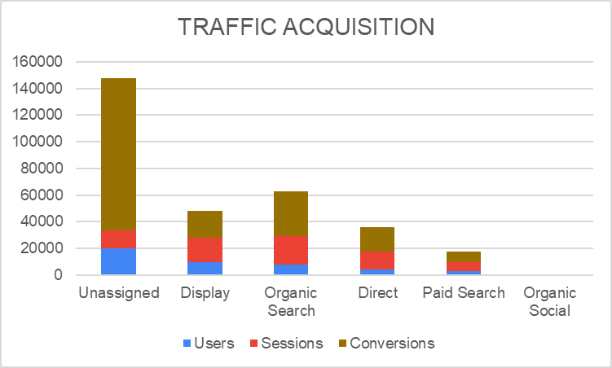
TRAFFIC ACQUISITION

Slide 17
According to the user count ‘unassigned’, is plays vital role here .
‘Display‘, ‘Organic search’, ‘Direct ‘, ‘Paid search’, ‘Organic social’ are coming under next.
Tracking and assigning the source of unassigned traffic is crucial.
Regularly monitor traffic sources and adapt strategies to achieve sustainable growth and success.

Slide 18
USER ACQUISITION

Slide 19
Continuous monitoring and adaptation of acquisition strategies are crucial to capitalize on successful channels and identify growth areas for sustained user acquisition.

